Slide 1

Data-X : Data Preprocessing and Feature Engineering
Data ^{X}
About Me:
Ikhlaq Sidhu Chief Scientist & Founding Director, Sutardja Center for Entrepreneurship & Technology IEOR Emerging Area Professor Award, UC Berkeley

Slide 2
Data Preprocessing
Assume we are given a data matrix X of size [N x D], where N is the number of observations and D is the dimensionality of each observation
We will consider the following 3 types of data preprocessing techniques:
Mean Subtraction
Normalization
PCA and Whitening
Without Data Pre-Processing, our results would simply be:
Garbage in, Garbage out

Slide 3
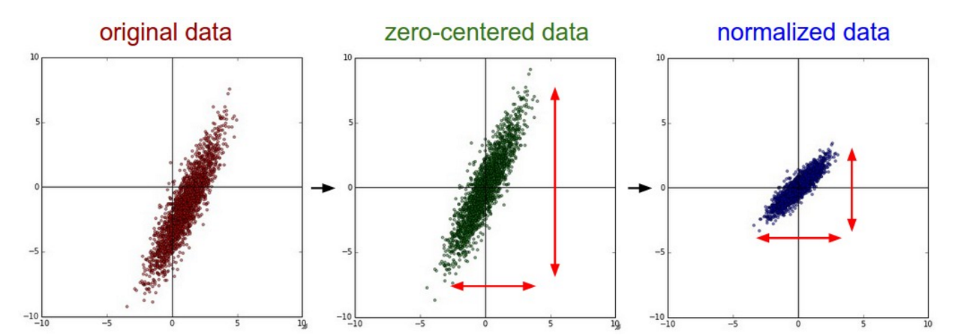
Data Preprocessing II
Mean Subtraction
Subtract the mean across every feature in the data
Geometrically, we want to center the cloud of data around the origin along every dimension
In Python, the following function suffices:
X -= np.mean(X, axis = 0)
Normalization
Geometrically, we want the features to be approximately on the same scale
2 common ways
Divide the features by its standard deviation after mean subtraction
Normalizing

Slide 4
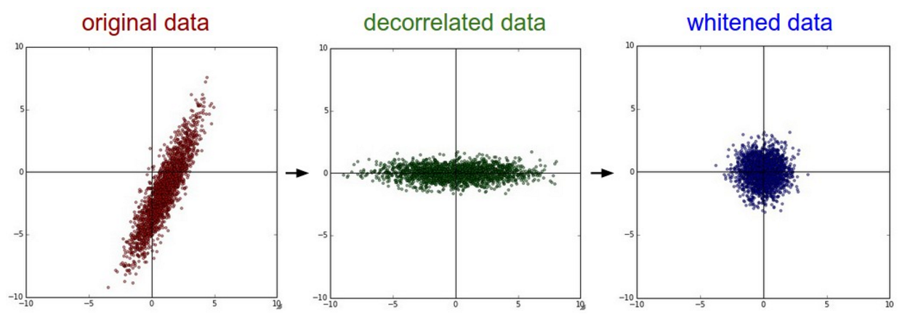
Data Preprocessing II
PCA and Whitening:
After mean subtraction, we can perform principal component analysis which allows us to compute the covariance matrix across the feature space
Allows for efficient dimensionality reduction and we may select a subset of the transformed features (principal components) for training
The whitening transformation, on the other hand, takes the data in the eigenbasis and divide every dimension by the eigenvalue (from the PCA step)
Final Recommendation: The recommended preprocessing is to simply center the data to have mean of zero and normalize its scale to [-1, 1] along each feature

Slide 5
Feature Engineering
Many tasks in machine learning are highly dependent on feature engineering supplemented by model tuning and ensemble learning
Feature engineering gets you very far
Use domain knowledge when you can
When you feel that a variable is intuitively useful for the task, include it and try it as a feature:
Always check and see if it works!

Slide 6
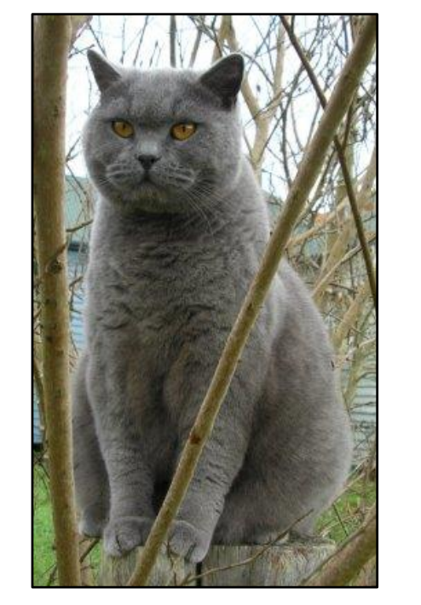
Image Classification: Feature Engineering
Assume that we are given a set of discrete labels:
Cats, Dogs, Elephants, Ships
Question: What should we use as predictors?
Cats

Slide 7
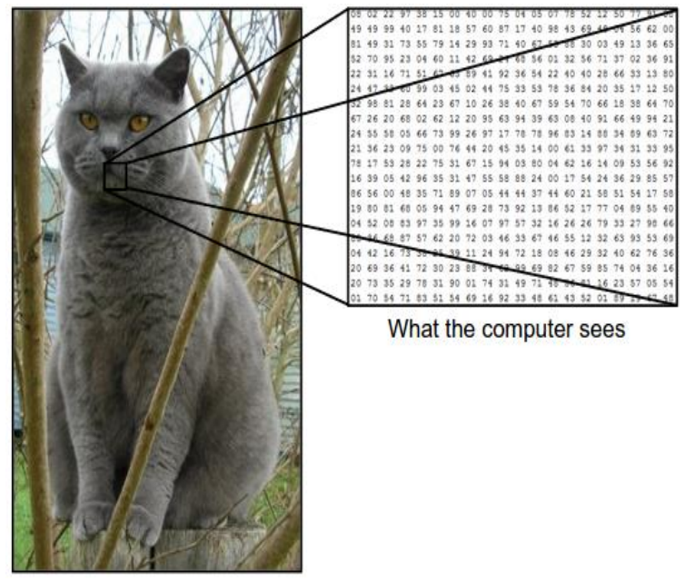
What does a computer “see”?
Images are arrays of numbers
Images are represented as 3D arrays of numbers, with integers between [0,255] i.e. 32 x 32 x 3 (a stack of 3 2-D arrays representing the 3 color channels RGB)
Features we can use:
raw pixels
Features created from the raw images

Slide 8
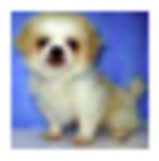

Training on Raw Pixel
$$f\left(x, W\right)=Wx$$
W: Parameters (Weights)
x: Input
f(x, W): Score
10 numbers indicating class scores
[32 x 32 x 3] array of numbers
X: is a 32 x 32 x 3 image (flattened into a vector)!!!

Slide 9
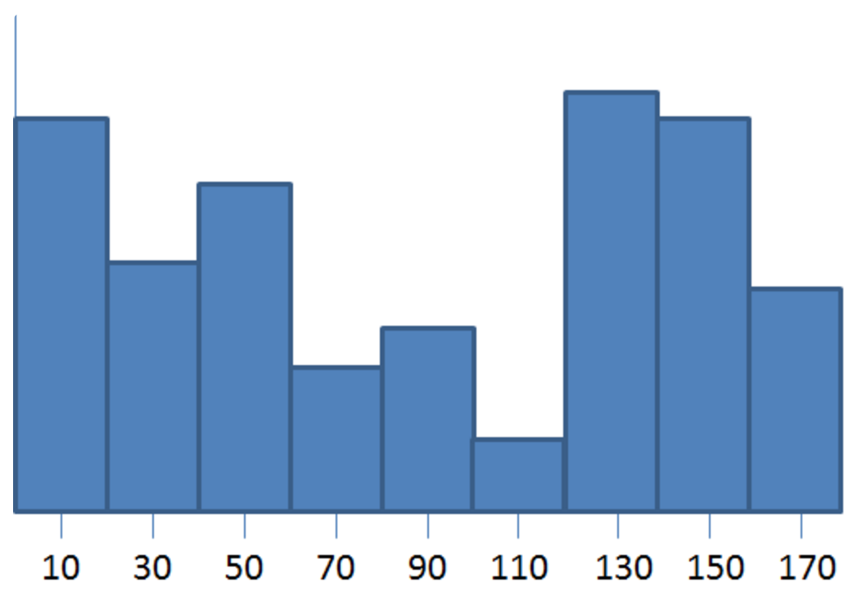
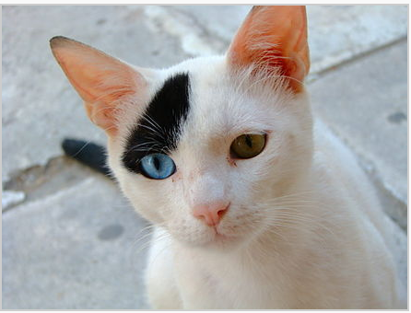
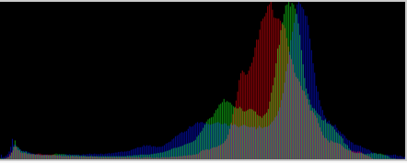
Feature Engineering: HOG, Color Histogram
HOG (Histograms of Oriented Gradients)
A type of feature descriptor
Goal: generalize the object in such a way that the same image viewed under different conditions would create the same feature descriptor
Within each cell, we compute the gradient vector at each pixel
We take a the gradient vectors of a predefined batch size and bin them in a histogram (Quantization)
Color Histogram
Representation of the distribution of colors in an image

Slide 10
Training on derived features
$$f\left(x, W\right)=Wx$$
W: Parameters (Weights)
x: Input
f(x, W): Score
10 numbers indicating class scores
[32 x 32 x 3] array of numbers
X: HOG, Color Histogram, etc (flattened into a vector)!!!

Slide 11
End of Section

